Slide 1
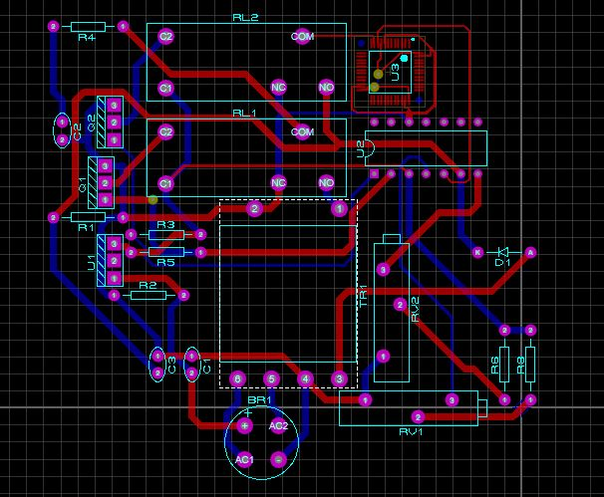





Overvoltage protection
Submitted by – Group B2.14
Syed Mortuza Hasan
1606108
Mehedi Hasan Emon
1606113
Tanvir Anjum
1606115
Minhajur Rahman
1606126

Slide 2
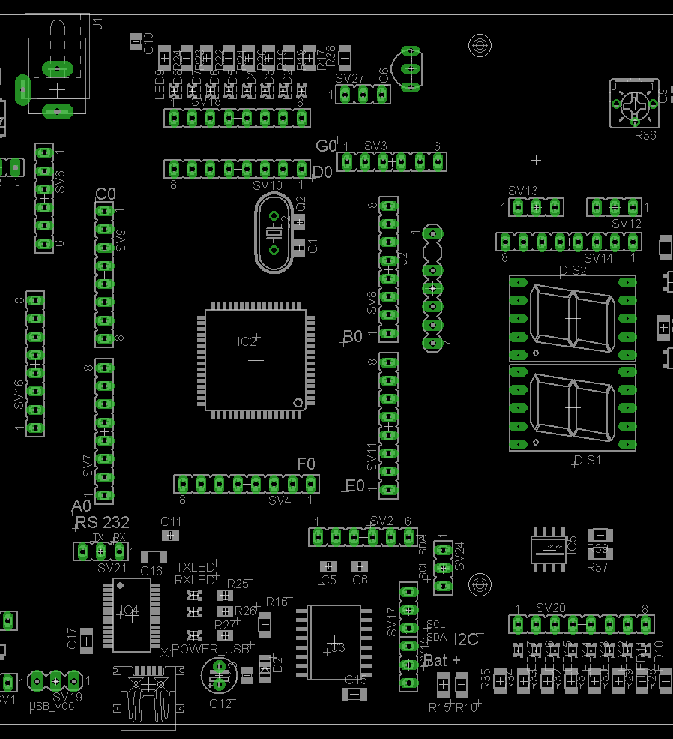
Outline
Summary
Background
Methods
Simulation
PCB layout and 3d rendering
Future Outlook
Conclusion
This Photo by Unknown author is licensed under CC BY-SA.

Slide 3
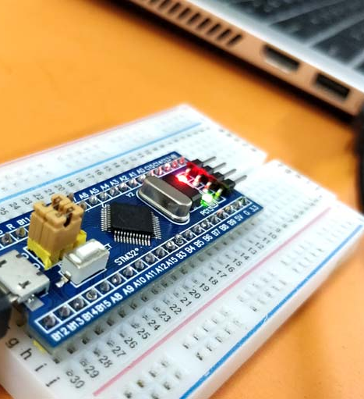
Summary
An STM32F103C6 based Digital Overvoltage Protection Circuit for Industrial Load is simulated Using Proteus® Software.

Slide 4

Background
Vaarious external and internal phenomena cause a power supply voltage to overflow. Overvoltage in power system can cause serious harm to load material or cause overheating. In extreme cases, overvoltage may melt electric cables, cause electric/ electronic devices to malfunction and even cause fire hazard.

Slide 5
Methods
Relay​
Power Supply
Load
Microcontroller
Dual winding Transformer
Microcontroller Protection Circuit
Voltage Sensing Circuit
Relay​

Slide 6
Methods
We used an step down dual secondary winding transformer to bring down the line voltage to a measurable quantity.
The Voltage sensing circuit performs full-wave rectification to convert the voltage to DC and feeds it to the microcontroller for sensing
The microcontroller protection circuit senses the line voltage and controls the flow from Voltage sensing circuit to microcontroller in order to protect the microcontroller from malfunction
The microcontroller precisely senses the voltage and controls the connection between load and supply line.
The line voltage is displayed through three seven segment displays

Slide 7


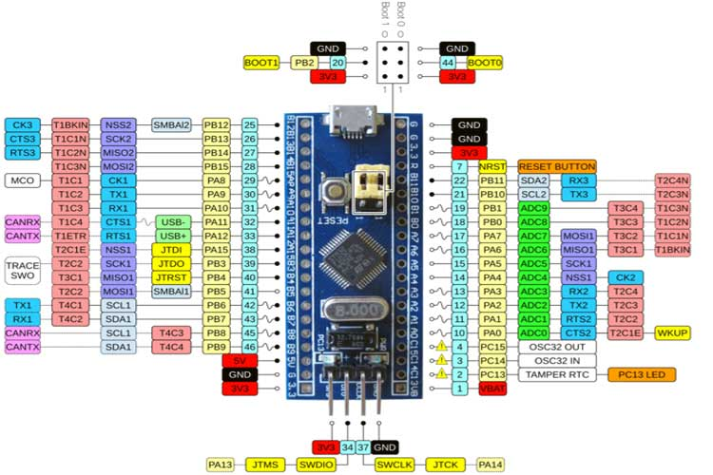
Coding: Introduction
Compiler:
STM32CubeIDE
Language:
C – programming language
Microprocessor:
STM32F103C6

Slide 8
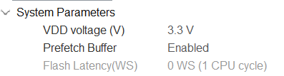
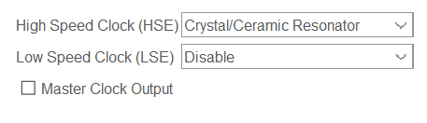
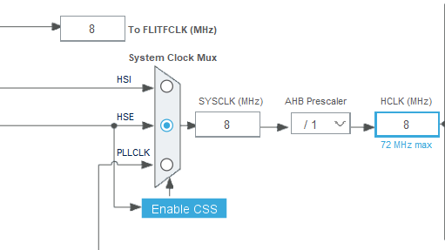
Coding: Clock Configuration
Clock Selected:
High Speed External (HSE)
Clock source:
Crystal/Ceramic Resonator
Logic voltage:
3.3V

Slide 9
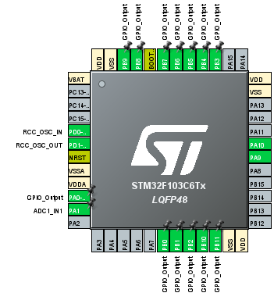
STM32 (Pinout)
PA1: takes an analog input between 0 and 3.3V for voltage sensing
PA0: sends the controlling logic to the load-relay controlling circuit, output type: no pushup-no pulldown
PA9: USART receiving pin
PA10: USART transmission pin
PB0-PB11: outputs the control word to the three 7 segment display, output type: pull down

Slide 10
Coding:
while (1)​
{​
HAL_ADC_Start(&hadc1);​
HAL_ADC_PollForConversion(&hadc1, HAL_MAX_DELAY);​
raw = HAL_ADC_GetValue(&hadc1);​
temp = temp + raw;​
i = i + 1;​
if (i==10){​
x = temp/10;​
temp = 0;​
i=0;​
voltage = (x-1491)/5.6409 + 360;​
sprintf(msg, "%hu\r\n", voltage);​
HAL_UART_Transmit(&huart1, (uint8_t*)msg,strlen(msg), HAL_MAX_DELAY);​
}​
​
Description:
Raw voltage information is read through ADC using polling method​
The raw values are averaged over a period​
A linear relationship was established using two data points of raw data and voltage​
Actual voltage is measured using the relationship​
The value of the voltage is sent to virtual terminal for debugging​

Slide 11
Coding:
a = floor(voltage/100);
b = floor(voltage/10);
b= b%10;
b = b<<4;
c = voltage%10;
c = c<<8;
GPIOB->ODR = a|b|c;
if (raw<60)
GPIOB->ODR = 0;
HAL_Delay(1);
if((voltage>466)||(raw<60))
{
HAL_GPIO_WritePin(GPIOA, GPIO_PIN_0, 0);
}
else
{
HAL_GPIO_WritePin(GPIOA, GPIO_PIN_0, 1);
}
}
}
Descriptions:
Since our three BCD 7 segment displays are connected with pins PB0-11, a 12-bit word is generated using four bits for each unit, tenth and hundredth digit
The 12-bit word is then sent to the Output Data Register of the Port B
If the measured voltage is greater than 6% of rated voltage of 440V for industrial usage, the load connecting relay is energized through mosfet
Otherwis the relay is de-enegized

Slide 12
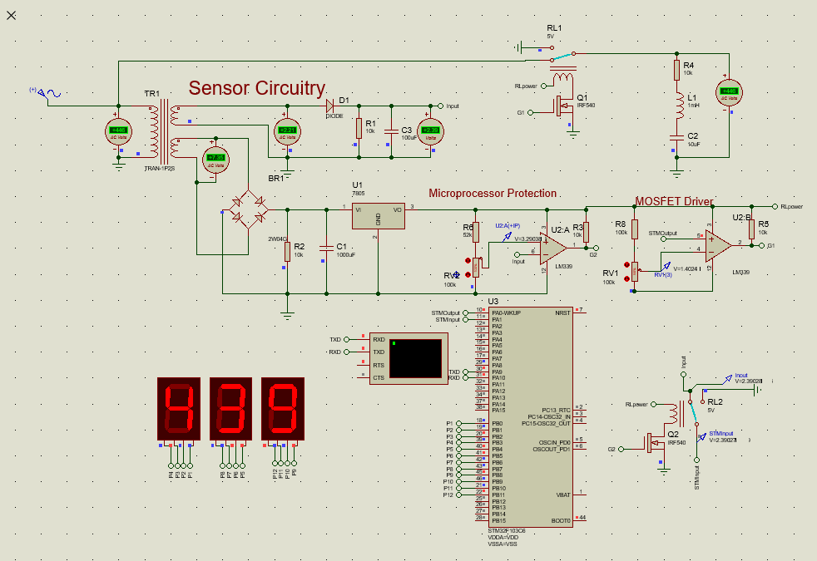
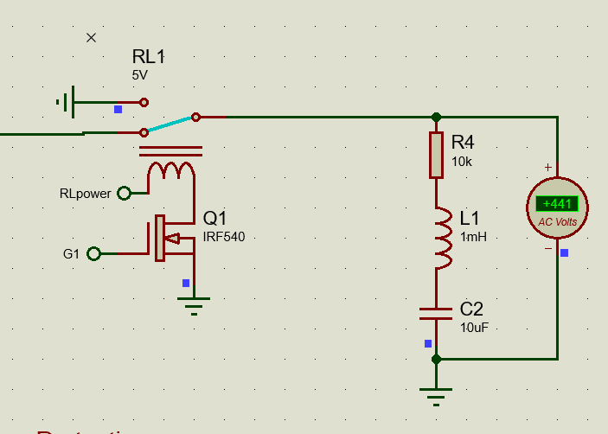
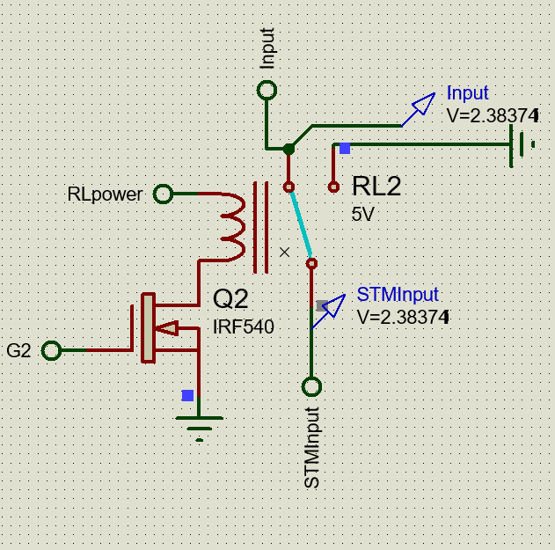
Simulation (Normal Operation)

Slide 13
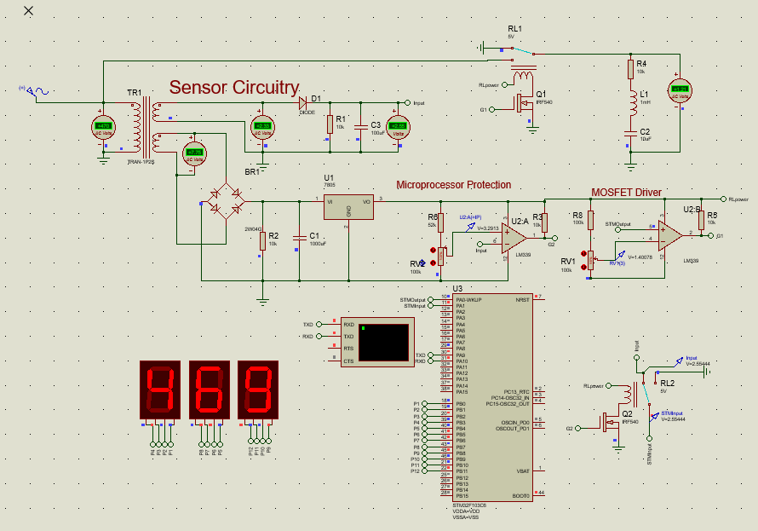
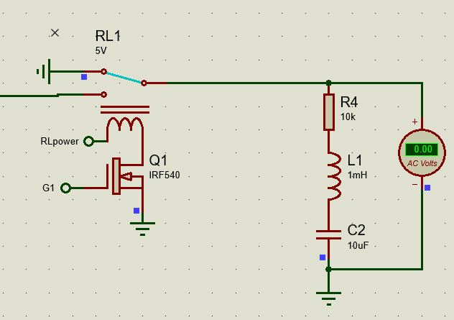
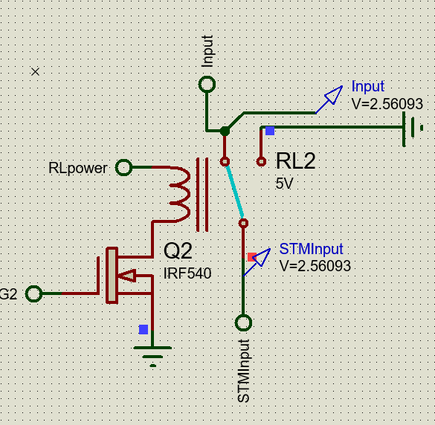
Simulation (Overvoltage)

Slide 14
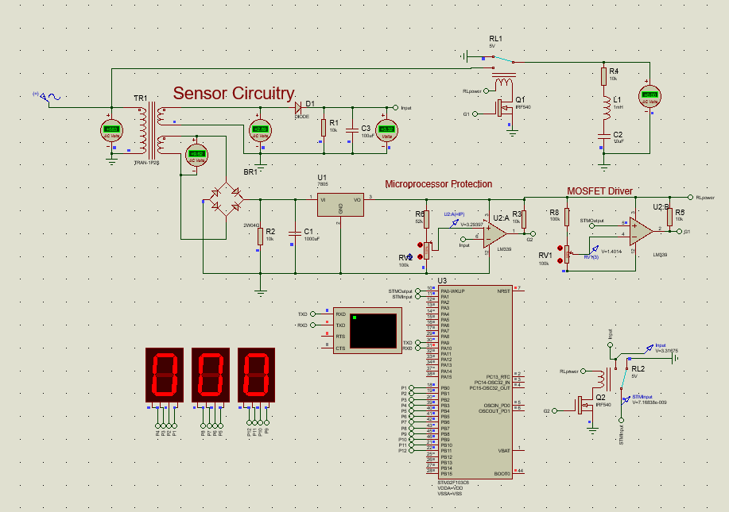
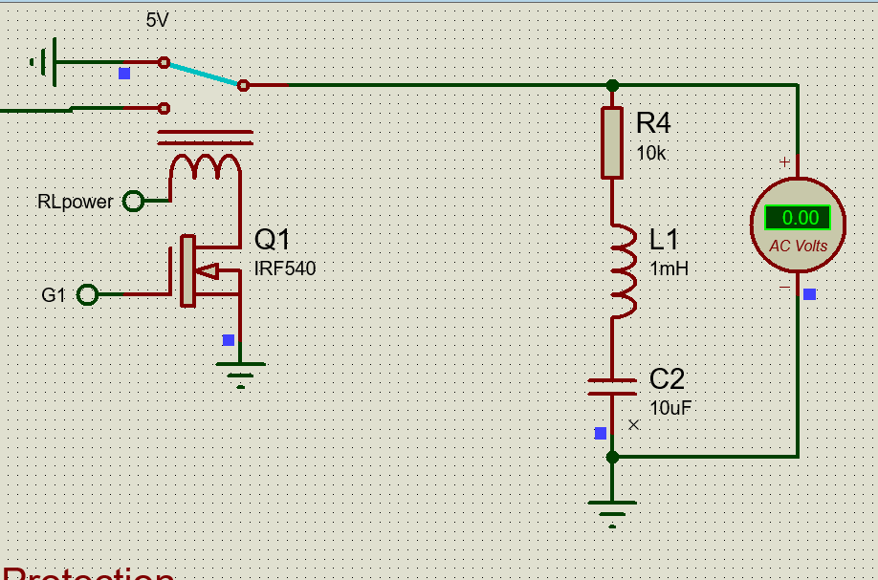
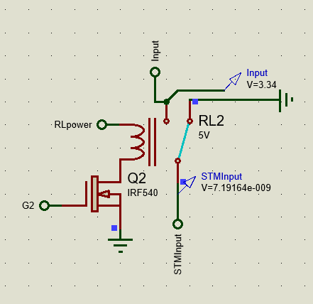
Simulation (Overvoltage)

Slide 15
PCB Layout
Software Used:
Proteus
Dual Layers. Blue and Red.
Figure: PCB Layout

Slide 16
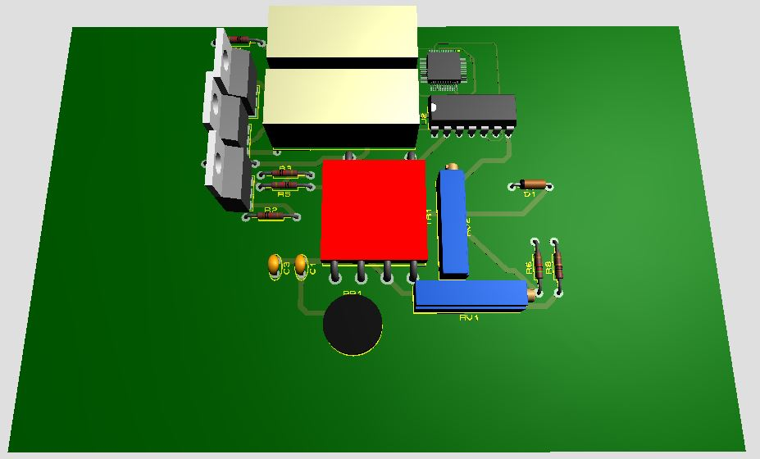
3d rendering
Software Used: Proteus
Figure: 3D Rendering

Slide 17
Future Outlook
1.Implement in real life with hardware
2.Printing the PCB for practical usage
3.Undervoltage Protection
4.Unstable Frequency Protection

Slide 18
Conclusion
The number of expensive electronic devices in private households has risen sharply in the last few years. In addition, electric appliances are becoming ever smaller and more powerful; however, they thus also react more sensitively to over voltages.
The subsequent financial damage and hassle is great when expensive electric appliances such as televisions, computers and food processors are damaged by lightning strikes and over voltages. To prevent these over voltages, overvoltage protection can reduce occurring voltage peaks to a level that is not dangerous for the terminal device.

Slide 19
Additional Slides

Slide 20
References
https://pdf1.alldatasheet.com/datasheet-pdf/view/201588/STMICROELECTRONICS/STM32F103C6.html
https://www.alldatasheet.com/view.jsp?Searchword=Irf540%20datasheet&gclid=CjwKCAjwgISIBhBfEiwALE19Se-YWNmCKHELvi1W34DGLMwYtGmy9618Dk2r0D5a4m65V_mQ0gBAUBoCfZcQAvD_BwE&fbclid=IwAR2RBxTMbDqrJpRa_oAzzf4MzhKFN8KeZ_L7IzePPgOcvZXpNRRWTl_gWxg
https://www.alldatasheet.com/view.jsp?Searchword=Lm339%20datasheet&gclid=CjwKCAjwgISIBhBfEiwALE19SWUDzAa8ohoZaRpWowEGKEHUA3Z_6453KZUUkh0k_80SxKZzoUhi-RoC_l0QAvD_BwE&fbclid=IwAR3-yF5OXz1ZiI2tDoUphib6ZT3vgpngwWi8zfFAm24umYYv2bjkQbFsP3s

Slide 21
Bill of Materials
1x STM32F103C6
2x 5V Relay
2x LM339
3x BCD 7 segment display
1x Dual secondary winding Transformer
2x IRF540 MOSFET
1x Full bridge rectifier
1x diode
1x 7805 IC
5 x10k, 1x 52k,1x 100k resistors
2x 100k variable resistors
1x 10uF, 1x 100uF, 1x 1mF capacitors
1x 1mH Inductor
Wires

Slide 22
Detailed Methods
Software used:
Proteus 8 Professional v 8.10 SP3 ()
STM 32 Cube IDE 1.6.1
Tutorials :
https://youtu.be/gL8OoS9E1rw
https://youtu.be/bX9m7KwA-8Y
https://youtu.be/rfBeq-Fu0hc
https://www.engineersgarage.com/accessing-ports-of-stm32-microcontroller/

Slide 23
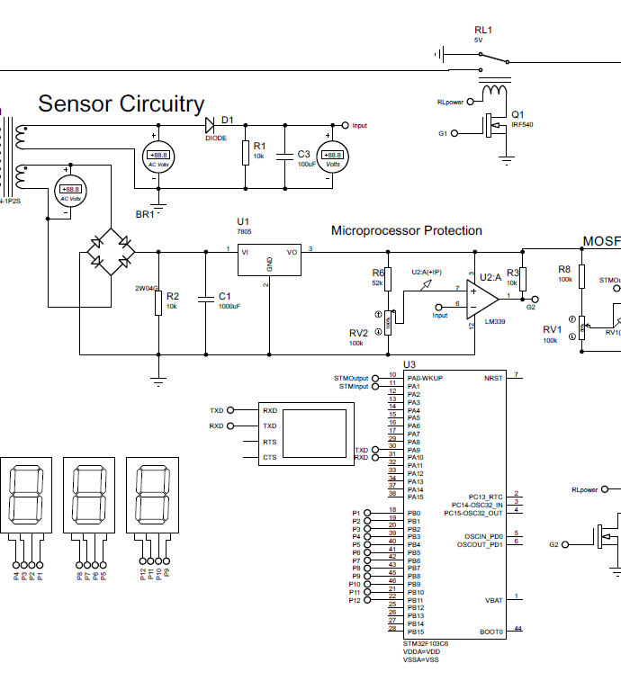
Circuit Diagram
PDF Link:
https://buetedu-my.sharepoint.com/:b:/g/personal/1606115_eee_buet_ac_bd/EZxj0MIKPdJOhWtbxd2vZdcBkjYmVESjbPqzSosBCdxEzw?e=cTpvTu

Slide 24
Source Codes
#include "main.h"
#include <string.h>
#include <stdio.h>
#include<math.h>
ADC_HandleTypeDef hadc1;
UART_HandleTypeDef huart1;
void SystemClock_Config(void);
static void MX_GPIO_Init(void);
static void MX_ADC1_Init(void);
static void MX_USART1_UART_Init(void);
int main(void)
{
uint16_t raw;
uint16_t temp;
uint16_t x;
uint16_t a;
uint16_t b;
uint16_t c;
uint16_t voltage;
uint16_t i;
i = 0;
temp = 0;
char msg[10];
Descriptions:
Imports the necessary libraries
Declares System Clock, General Pupose Input Output Pins(GPIO), Analog to Digital Converter and Universal Synchronous/Asynchronous Receiver/Transmitter configuration functions
Initialize Variables:
raw = value from adc
temp = temporary variable
x = average value over a period
a = hundredth digit of voltage
b = tenth digit of voltage
c = unit digit of voltage
voltage = the measured rms voltage
i = counter variable
msg = string for communication with tx,rx

Slide 25
Source Codes
Descriptions:
Necessary peripherals are initialized
Raw voltage information is read through ADC using polling method
The raw values are averaged over a period
A linear relationship was established using two data points of raw data and voltage
Actual voltage is measured using the relationship
The value of the voltage is sent to virtual terminal for debugging
HAL_Init();
SystemClock_Config();
MX_GPIO_Init();
MX_ADC1_Init();
MX_USART1_UART_Init();
while (1)
{
HAL_ADC_Start(&hadc1);
HAL_ADC_PollForConversion(&hadc1, HAL_MAX_DELAY);
raw = HAL_ADC_GetValue(&hadc1);
temp = temp + raw;
i = i + 1;
if (i==10){
x = temp/10;
temp = 0;
i=0;
voltage = (x-1491)/5.6409 + 360;
sprintf(msg, "%hu\r\n", voltage);
HAL_UART_Transmit(&huart1, (uint8_t*)msg,strlen(msg), HAL_MAX_DELAY);
}

Slide 26
Source Codes
a = floor(voltage/100);
b = floor(voltage/10);
b= b%10;
b = b<<4;
c = voltage%10;
c = c<<8;
GPIOB->ODR = a|b|c;
if (raw<60)
GPIOB->ODR = 0;
HAL_Delay(1);
if((voltage>466)||(raw<60))
{
HAL_GPIO_WritePin(GPIOA, GPIO_PIN_0, 0);
}
else
{
HAL_GPIO_WritePin(GPIOA, GPIO_PIN_0, 1);
}
}
}
Descriptions:
Since our three BCD 7 segment displays are connected with pins PB0-11, a 12-bit word is generated using four bits for each unit, tenth and hundredth digit
The 12-bit word is then sent to the Output Data Register of the Port B
If the measured voltage is greater than 6% of rated voltage of 440V for industrial usage, the load connecting relay is energized through mosfet
Otherwis the relay is de-enegized

Slide 27
Source Codes
void SystemClock_Config(void)
{
RCC_OscInitTypeDef RCC_OscInitStruct = {0};
RCC_ClkInitTypeDef RCC_ClkInitStruct = {0};
RCC_PeriphCLKInitTypeDef PeriphClkInit = {0};
RCC_OscInitStruct.OscillatorType = RCC_OSCILLATORTYPE_HSE;
RCC_OscInitStruct.HSEState = RCC_HSE_ON;
RCC_OscInitStruct.PLL.PLLState = RCC_PLL_NONE;
if (HAL_RCC_OscConfig(&RCC_OscInitStruct) != HAL_OK)
{
Error_Handler();
}
RCC_ClkInitStruct.ClockType = RCC_CLOCKTYPE_HCLK|RCC_CLOCKTYPE_SYSCLK
|RCC_CLOCKTYPE_PCLK1|RCC_CLOCKTYPE_PCLK2;
RCC_ClkInitStruct.SYSCLKSource = RCC_SYSCLKSOURCE_HSE;
RCC_ClkInitStruct.AHBCLKDivider = RCC_SYSCLK_DIV1;
RCC_ClkInitStruct.APB1CLKDivider = RCC_HCLK_DIV1;
RCC_ClkInitStruct.APB2CLKDivider = RCC_HCLK_DIV1;
if (HAL_RCC_ClockConfig(&RCC_ClkInitStruct, FLASH_LATENCY_0) != HAL_OK)
{
Error_Handler();
}
PeriphClkInit.PeriphClockSelection = RCC_PERIPHCLK_ADC;
PeriphClkInit.AdcClockSelection = RCC_ADCPCLK2_DIV2;
if (HAL_RCCEx_PeriphCLKConfig(&PeriphClkInit) != HAL_OK)
{
Error_Handler();
}
}
Descriptions:
CubeIDE generated configuration code for Internal Clock

Slide 28
Source Codes
static void MX_ADC1_Init(void)
{
hadc1.Instance = ADC1;
hadc1.Init.ScanConvMode = ADC_SCAN_DISABLE;
hadc1.Init.ContinuousConvMode = DISABLE;
hadc1.Init.DiscontinuousConvMode = DISABLE;
hadc1.Init.ExternalTrigConv = ADC_SOFTWARE_START;
hadc1.Init.DataAlign = ADC_DATAALIGN_RIGHT;
hadc1.Init.NbrOfConversion = 1;
if (HAL_ADC_Init(&hadc1) != HAL_OK)
{
Error_Handler();
}
/** Configure Regular Channel
*/
sConfig.Channel = ADC_CHANNEL_1;
sConfig.Rank = ADC_REGULAR_RANK_1;
sConfig.SamplingTime = ADC_SAMPLETIME_1CYCLE_5;
if (HAL_ADC_ConfigChannel(&hadc1, &sConfig) != HAL_OK)
{
Error_Handler();
}
}
static void MX_USART1_UART_Init(void)​
{​
huart1.Instance = USART1;​
huart1.Init.BaudRate = 115200;​
huart1.Init.WordLength = UART_WORDLENGTH_8B;​
huart1.Init.StopBits = UART_STOPBITS_1;​
huart1.Init.Parity = UART_PARITY_NONE;​
huart1.Init.Mode = UART_MODE_TX_RX;​
huart1.Init.HwFlowCtl = UART_HWCONTROL_NONE;​
huart1.Init.OverSampling = UART_OVERSAMPLING_16;​
if (HAL_UART_Init(&huart1) != HAL_OK)​
{​
Error_Handler();​
}​
}​
​
Descriptions:
CubeIDE generated configuration code for ADC and USART

Slide 29
Source Codes
/*Configure GPIO pin : PA0 */
GPIO_InitStruct.Pin = GPIO_PIN_0;
GPIO_InitStruct.Mode = GPIO_MODE_OUTPUT_PP;
GPIO_InitStruct.Pull = GPIO_NOPULL;
GPIO_InitStruct.Speed = GPIO_SPEED_FREQ_LOW;
HAL_GPIO_Init(GPIOA, &GPIO_InitStruct);
/*Configure GPIO pins : PB0 PB1 PB2 PB3
PB4 PB5 PB6 */
GPIO_InitStruct.Pin = GPIO_PIN_0|GPIO_PIN_1|GPIO_PIN_2|GPIO_PIN_3
|GPIO_PIN_4|GPIO_PIN_5|GPIO_PIN_6;
GPIO_InitStruct.Mode = GPIO_MODE_OUTPUT_PP;
GPIO_InitStruct.Pull = GPIO_PULLDOWN;
GPIO_InitStruct.Speed = GPIO_SPEED_FREQ_LOW;
HAL_GPIO_Init(GPIOB, &GPIO_InitStruct);
/*Configure GPIO pins : PB10 PB11 PB7 PB8
PB9 */
GPIO_InitStruct.Pin = GPIO_PIN_10|GPIO_PIN_11|GPIO_PIN_7|GPIO_PIN_8
|GPIO_PIN_9;
GPIO_InitStruct.Mode = GPIO_MODE_OUTPUT_PP;
GPIO_InitStruct.Pull = GPIO_NOPULL;
GPIO_InitStruct.Speed = GPIO_SPEED_FREQ_LOW;
HAL_GPIO_Init(GPIOB, &GPIO_InitStruct);
}
}
static void MX_GPIO_Init(void)
{
GPIO_InitTypeDef GPIO_InitStruct = {0};
/* GPIO Ports Clock Enable */
__HAL_RCC_GPIOD_CLK_ENABLE();
__HAL_RCC_GPIOA_CLK_ENABLE();
__HAL_RCC_GPIOB_CLK_ENABLE();
/*Configure GPIO pin Output Level */
HAL_GPIO_WritePin(GPIOA, GPIO_PIN_0, GPIO_PIN_RESET);
/*Configure GPIO pin Output Level */
HAL_GPIO_WritePin(GPIOB, GPIO_PIN_0|GPIO_PIN_1|GPIO_PIN_2|GPIO_PIN_10
|GPIO_PIN_11|GPIO_PIN_3|GPIO_PIN_4|GPIO_PIN_5
|GPIO_PIN_6|GPIO_PIN_7|GPIO_PIN_8|GPIO_PIN_9, GPIO_PIN_RESET);
Descriptions:
CubeIDE generated configuration code for GPIO

Slide 30
Difficulties
Live voltage change during simulation was not possible as there was no variable ac voltage source in the proteus library.
In this design the microcontroller is powered by an independent source as connecting the microcontroller with the main power supply line might cause damage during the time when there is overvoltage.

